Slide 1

Energy Comparison
Alfred Francis

Slide 2
Introduction
We are checking on the following hypotheses:
Is Solar Power Energy more economically beneficial to the consumer?
Testing the monthly cost between Natural Gas and Solar Power.
Testing the monthly cost between Natural Gas and Wind Power.
Which energy power is more cost efficient?

Slide 3
T - Test
The first hypothesis:
This t-test will be on the comparison between Natural Gas Energy and Solar Power Energy.
It will test the monthly spending on these energy power for the monthly cost.

Slide 4
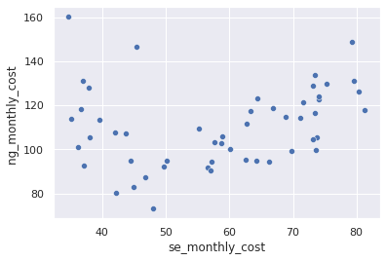
First Scatterplot
This scatterplot show that there’s a significant difference between Natural Gas Energy and Solar Power Energy.

Slide 5
T – Test Indication
What is indicated from the first t-test.
The result below shows that there is a significant difference between the energy cost of Natural Gas and Solar Power Energy.
The result below shows that there is a 95% confidence interval.
Ttest_indResult(statistic=16.072432880052858,
pvalue=1.8052470248657215e-29

Slide 6
First T-Test Conclusion
From the result of the t-test
The p-value is greater than 5%
This indicates that there is a significant difference between the Natural Gas Energy and the Solar Power Energy.

Slide 7
Second T-Test
The second hypothesis:
This t-test will be on the comparison between Natural Gas Energy and Wind Power Energy.
It will test the monthly spending between Natural Gas Energy and Wind Power Energy.

Slide 8
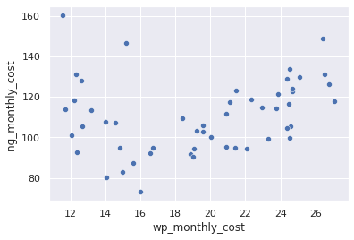
Second Scatterplot
This scatterplot shows that there’s a significant difference between Natural Gas Energy and Wind Power Energy.

Slide 9
Second T-Test Indication
What is indicated from the second t-test.
The result below shows that there is a significant difference between the energy cost of Natural Gas and Wind Power Energy.
The result below shows that there is a 95% confidence interval.
Ttest_indResult(statistic=34.95137181574872, pvalue=7.288143766906994e-58

Slide 10
Second T-Test Conclusion
From the result of the t-test
The p-value is greater than 5%
This indicates that there is a significant difference between the Natural Gas Energy and the Wind Power Energy.

Slide 11
Conclusion for both hypotheses
In both t-test the p-value is greater than 5%.
There is a significant statistical difference.
We have a Confidence Interval of 95%

Slide 12
Recommendation
I recommend the Solar Power Energy and/or Wind Power Energy over the Natural Gas Energy.

Slide 13
Thank You
Any Questions?

